Slide 1
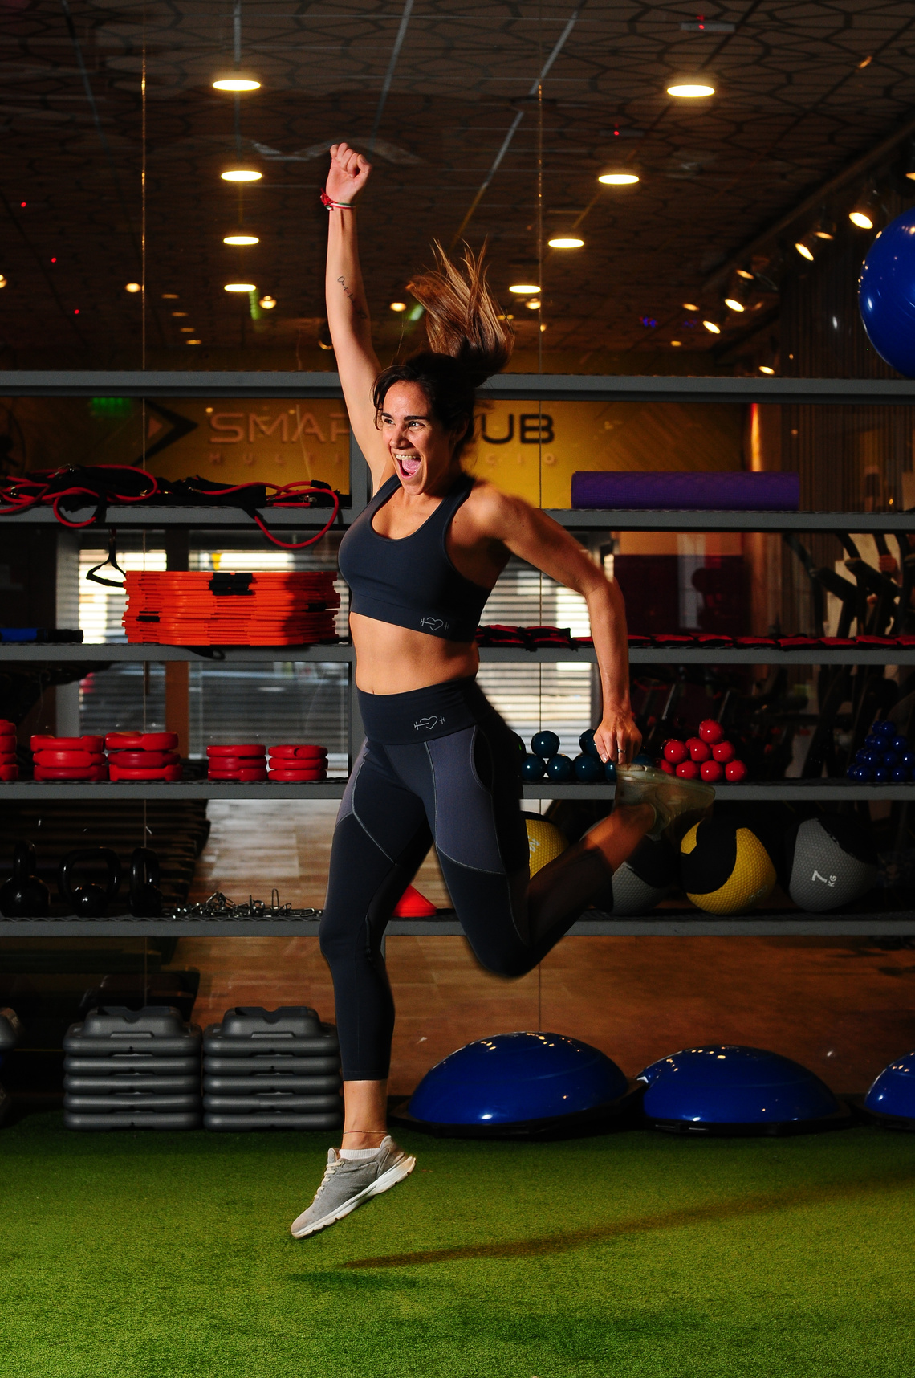
MA308 PROJECT
Workout Effectiveness
李宣樂 Lee Xuan Le, Chloe
邓雯文 Valen Tang Wenwen
刘珈闻

Slide 2
Points of Discussion
These are the broad topics that will be covered.
01
Data Preprocessing
02
Data Transformation
03
Data Evaluation
04
Conclusion

Slide 3

Data Preprocessing

Slide 4
01
Independent Variables
Main Variables
Weight (kg)
Height (m)
Max_BPM
Avg_BPM
Resting_BPM
Session_Duration (hours)
Workout_Type
Fat_Percentage
Water_Intake (liters)
Workout_Frequency (days/week)
Experience_Level
BMI
For Analysis
02
Dependent Variable
Calories_Burned

Slide 5
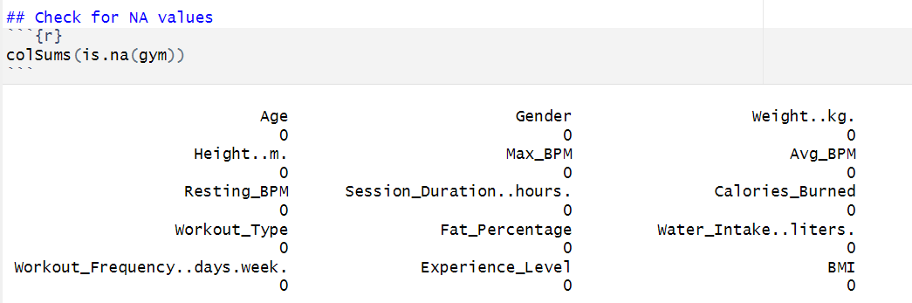
NA Values
No NA values

Slide 6
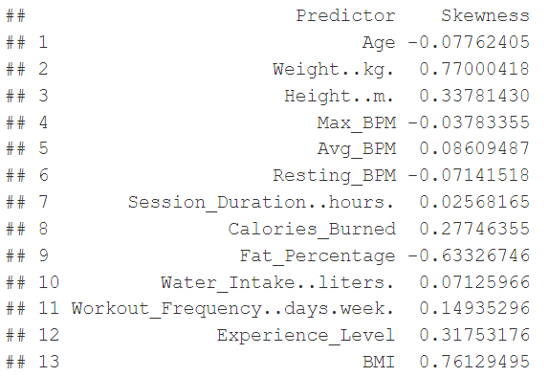
Skewness

Slide 7
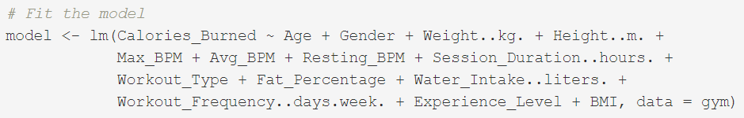
Multiple Regression Model
Include all possible variables

Slide 8
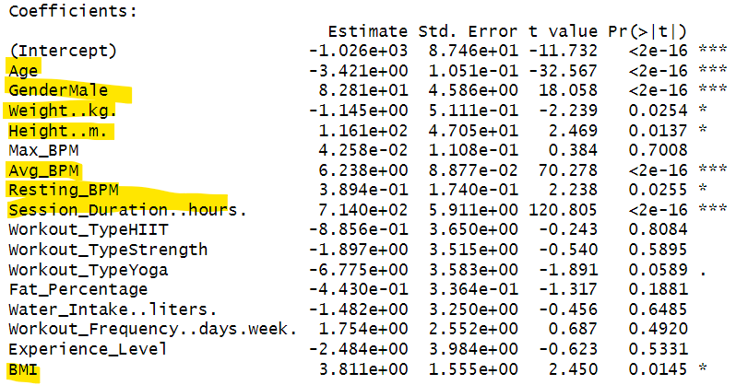
Multiple Regression Model
p-value<0.05: Suggests weak contribution to the model
Further evaluation is required

Slide 9
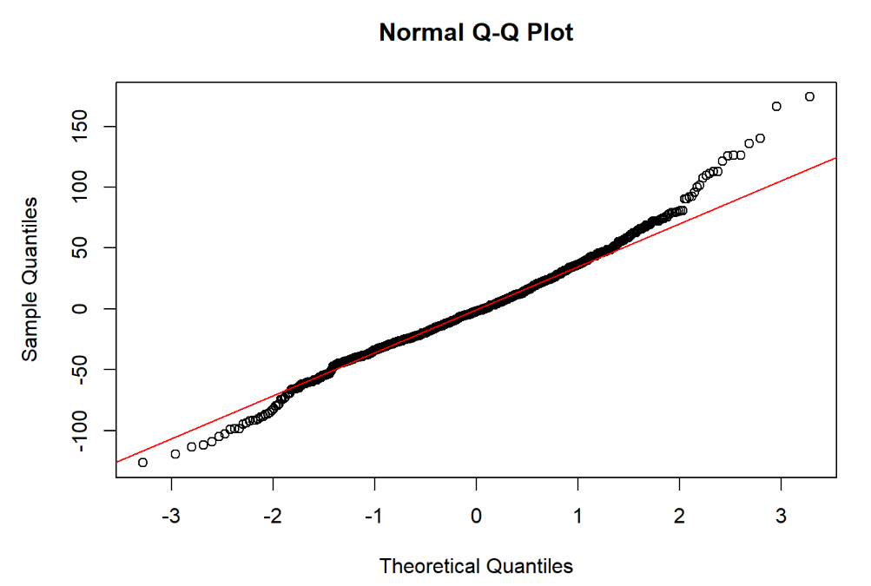
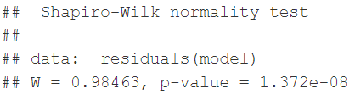
Normality
p-value<0.05: Suggests the normality assumption is not fulfilled

Slide 10
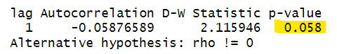
Independence
p-value>0.05: Suggests the independence assumption is fulfilled

Slide 11
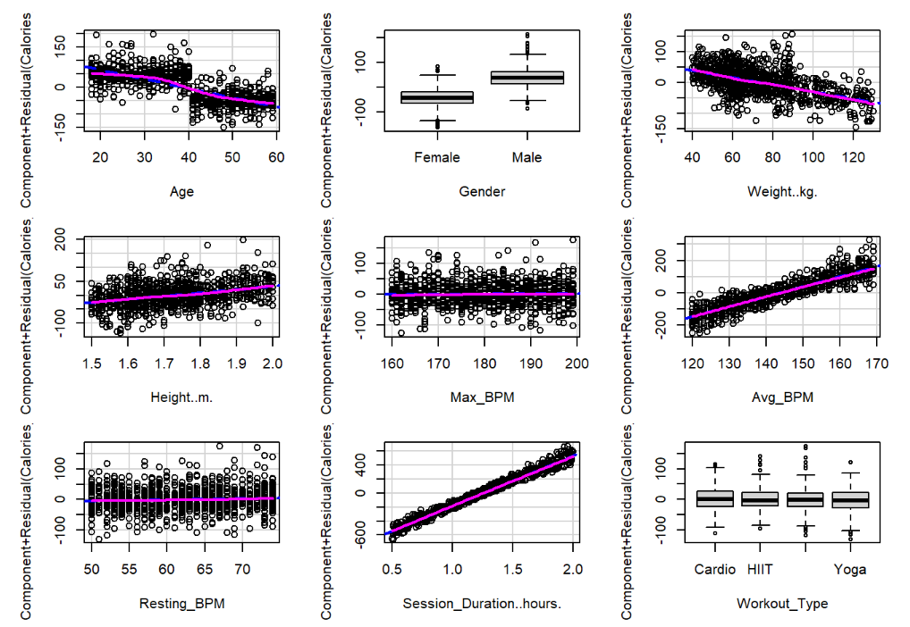
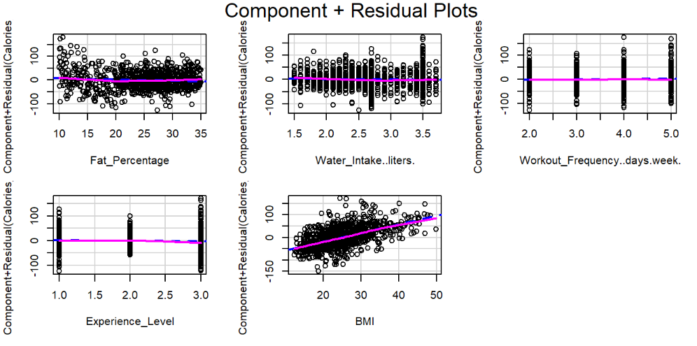
Linearity

Slide 12
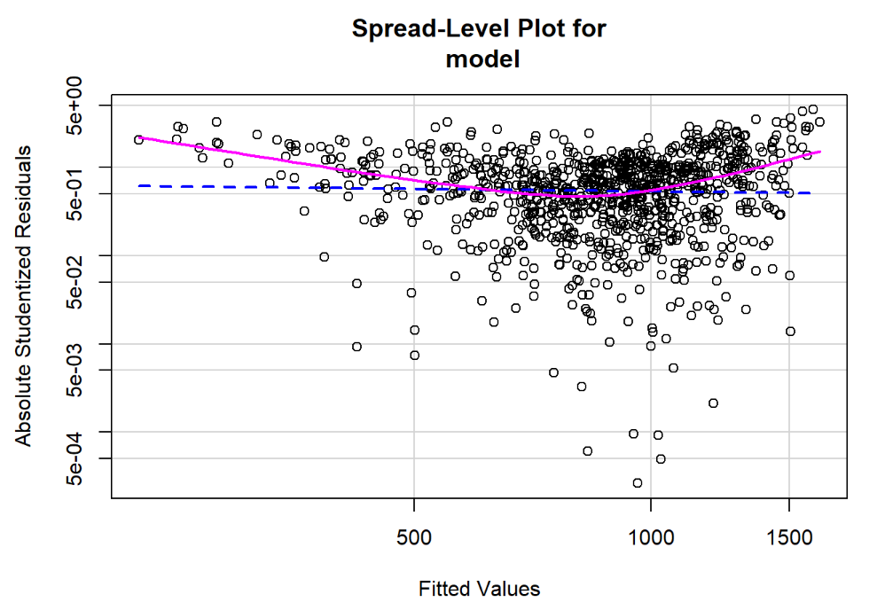
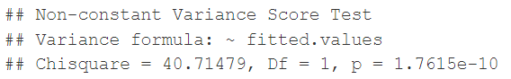
Homoskedasticity
p-value<0.05: Suggests the homoskedasticity assumption is not fulfilled

Slide 13
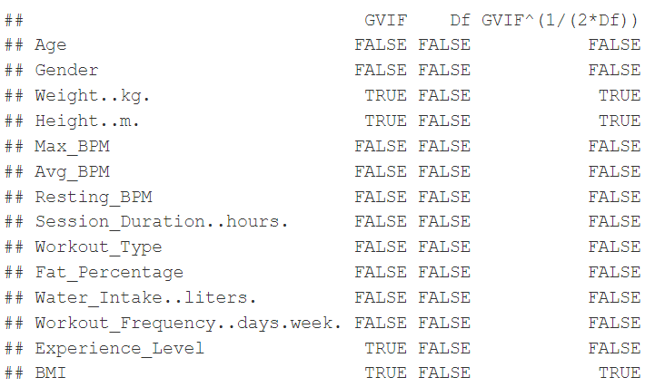
Multicollinearity

Slide 14
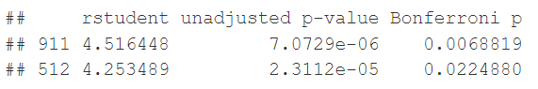
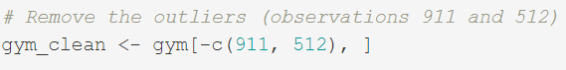
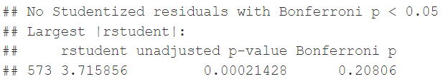
Outliers

Slide 15
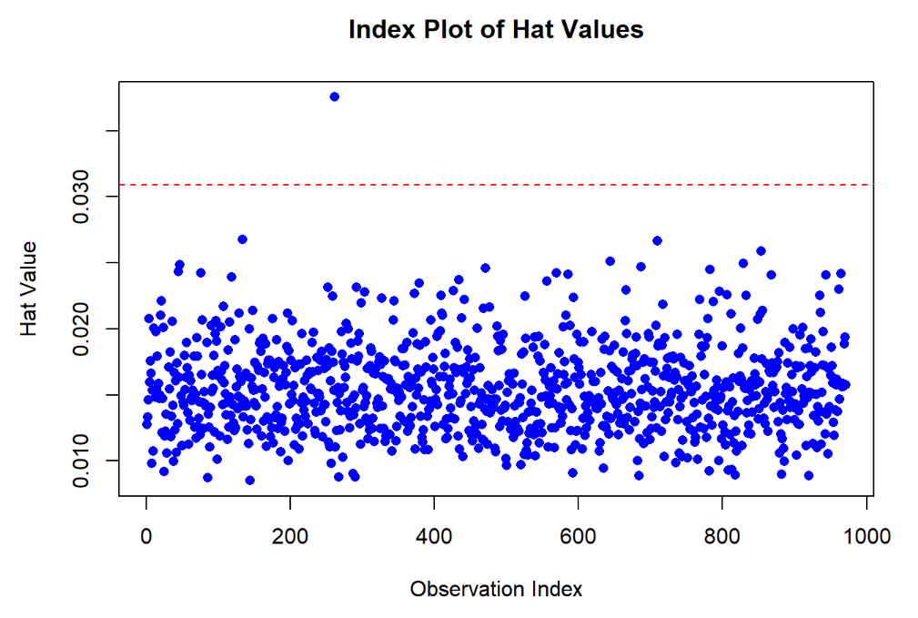

High Leverage Points

Slide 16
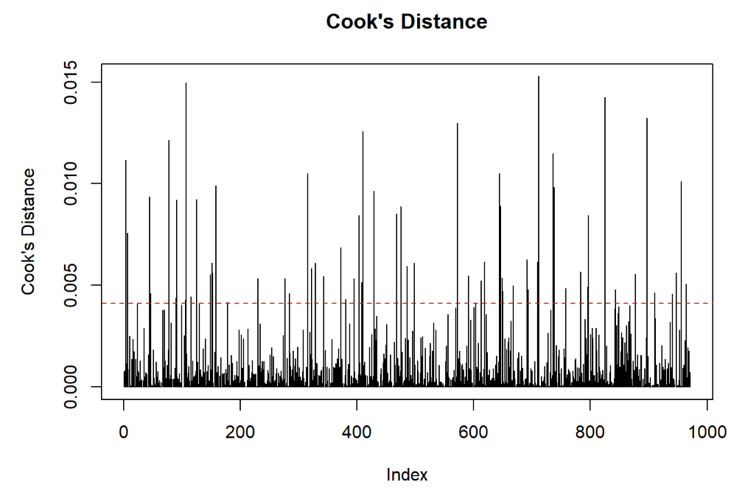
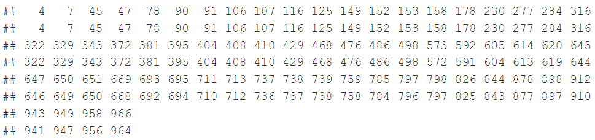
Influential observations

Slide 17
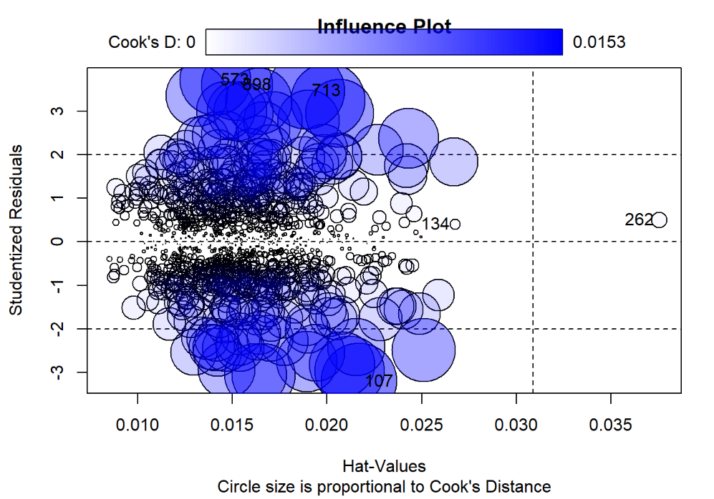
Influence Plot

Slide 18

Data Transformation
Fulfil the 4 Assumptions

Slide 19
Box-Cox Transformation

Slide 20
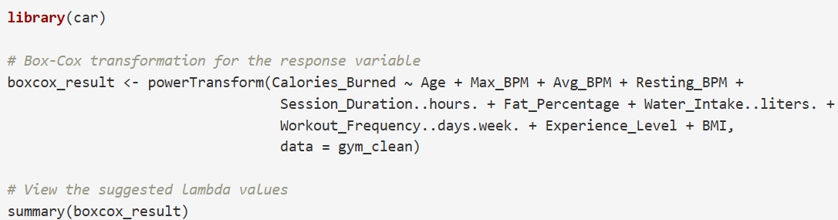
Box-Cox Transformation
Use of powerTransform

Slide 21
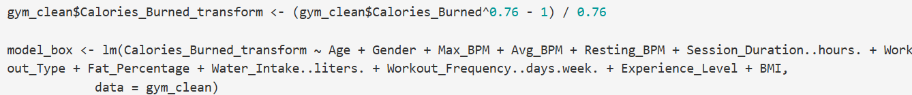
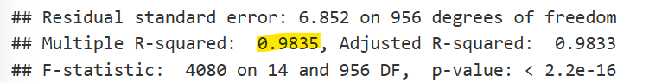
Box-Cox Transformation
Power value: 0.76
R^2 value: 0.983, good fit

Slide 22
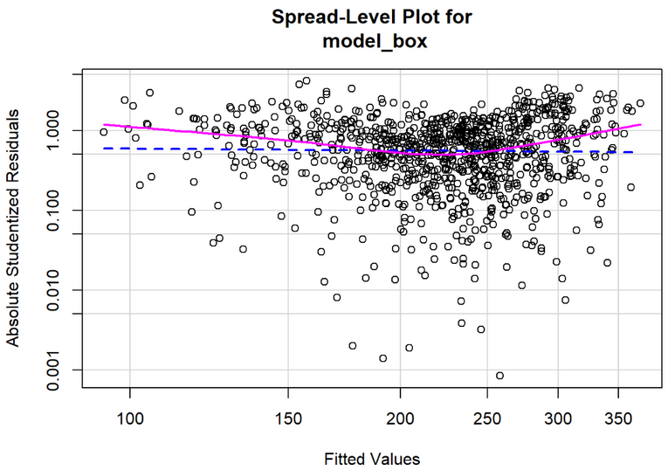
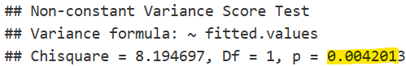
Box-Cox Analysis
4 Assumptions Test
Large W: Normality is satisfied
p-value for Durbin Watson Test >0.05: Independence is satisfied
No significant deviations from lines: Linearity is satisfied
p<0.05 on NCV test: Homoskedasticity is violated

Slide 23
Weighted Least Squares

Slide 24
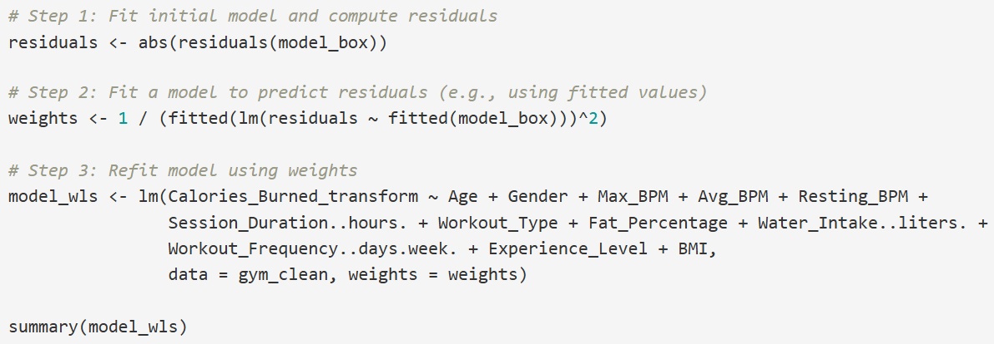
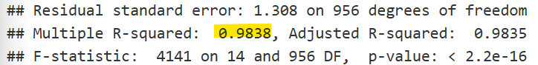
Weighted Least Squares

Slide 25

WLS Analysis
4 Assumptions Test
Large W: Normality is satisfied
p-value for Durbin Watson Test >0.05: Independence is satisfied
No significant deviations from lines: Linearity is satisfied
p>0.05 on NCV test: Homoskedasticity is satisfied

Slide 26
Stepwise Regression

Slide 27
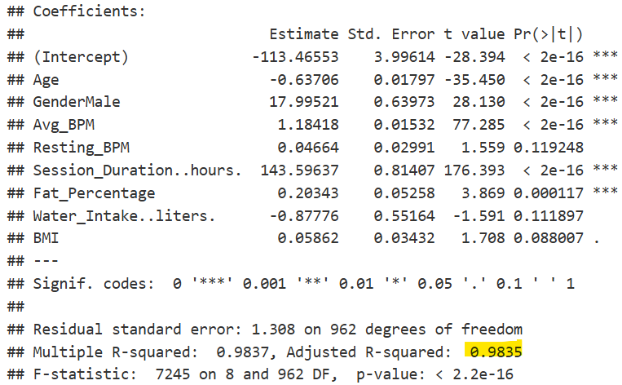
Stepwise Regression

Slide 28
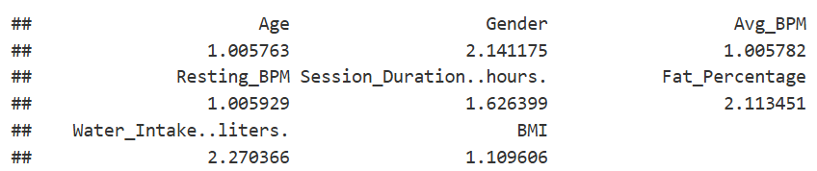
VIF & Multicollinearity
Small VIF: No Multicollinearity

Slide 29
Stepwise Regression Analysis
4 Assumptions Test
Large W: Normality is satisfied
p-value for Durbin Watson Test >0.05: Independence is satisfied
No significant deviations from lines: Linearity is satisfied
p>0.05 on NCV test: Homoskedasticity is satisfied
Additional Disadvantages
Coefficients seem oddly large

Slide 30
Standardised Stepwise Regression

Slide 31
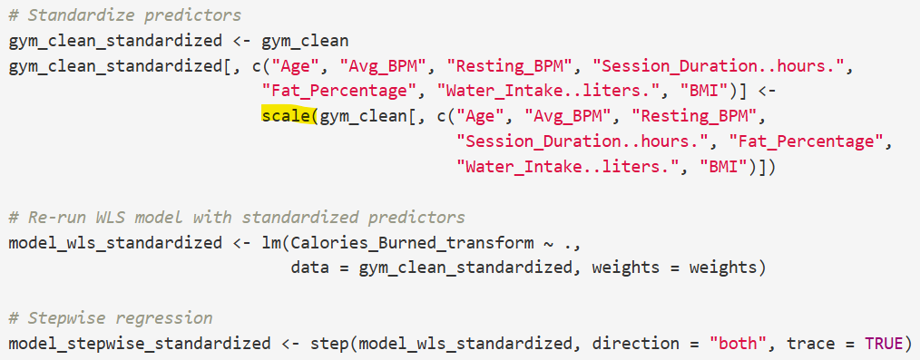
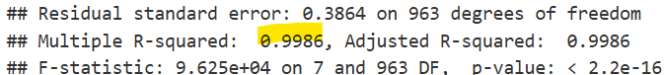
Standardisation

Slide 32
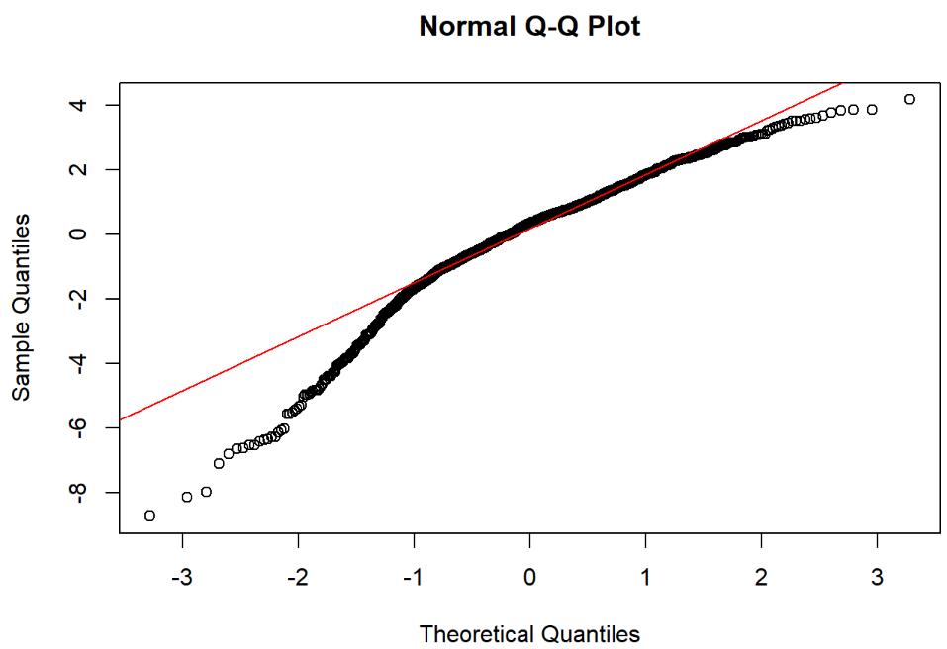
Standardised Stepwise Analysis
4 Assumptions Test
Small W and p: Normality is NOT satisfied
p-value for Durbin Watson Test >0.05: Independence is satisfied
No significant deviations from lines: Linearity is satisfied
p>0.05 on NCV test: Homoskedasticity is satisfied

Slide 33
All Subset Regression

Slide 34
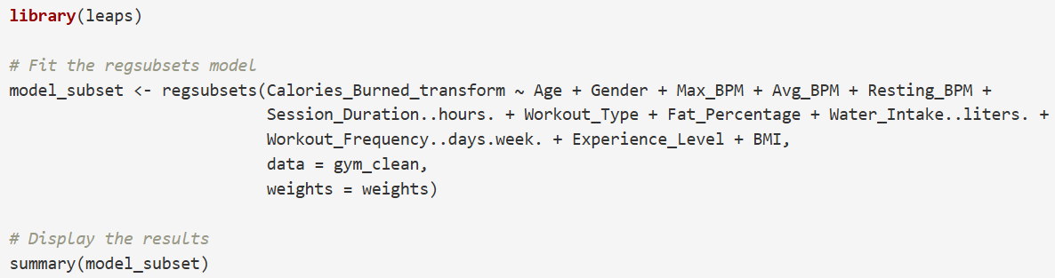
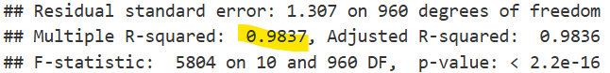
All Subset Regression

Slide 35
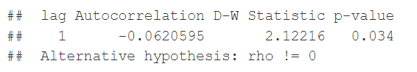
ASR Analysis
4 Assumptions Test
Large W: Normality is satisfied
p-value for Durbin Watson Test <0.05: Independence is NOT satisfied
No significant deviations from lines: Linearity is satisfied
p>0.05 on NCV test: Homoskedasticity is satisfied

Slide 36
Standardised All Subset Regression

Slide 37
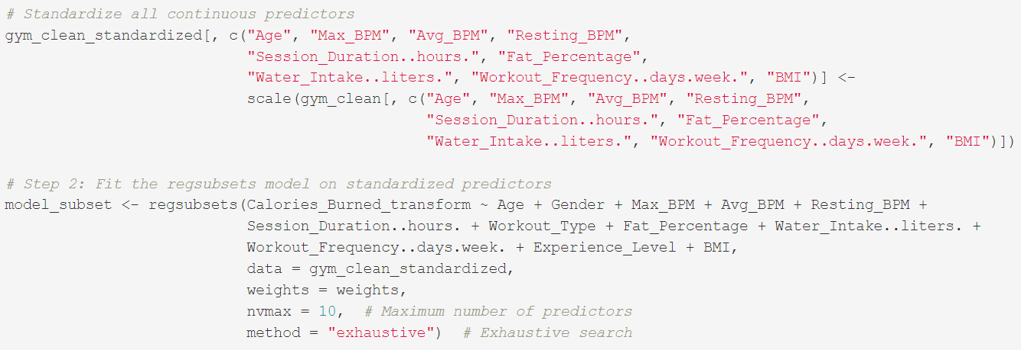
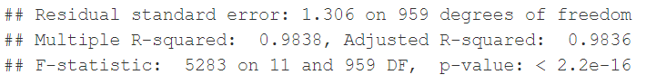
Standardisation

Slide 38
Standardised ASR Analysis
4 Assumptions Test
Large W: Normality is satisfied
p-value for Durbin Watson Test >0.05: Independence is satisfied
No significant deviations from lines: Linearity is satisfied
p>0.05 on NCV test: Homoskedasticity is satisfied
Additional Disadvantages
Coefficients still seem oddly large after standardisation

Slide 39

Data Evaluation
Choice of Model and Analysis

Slide 40
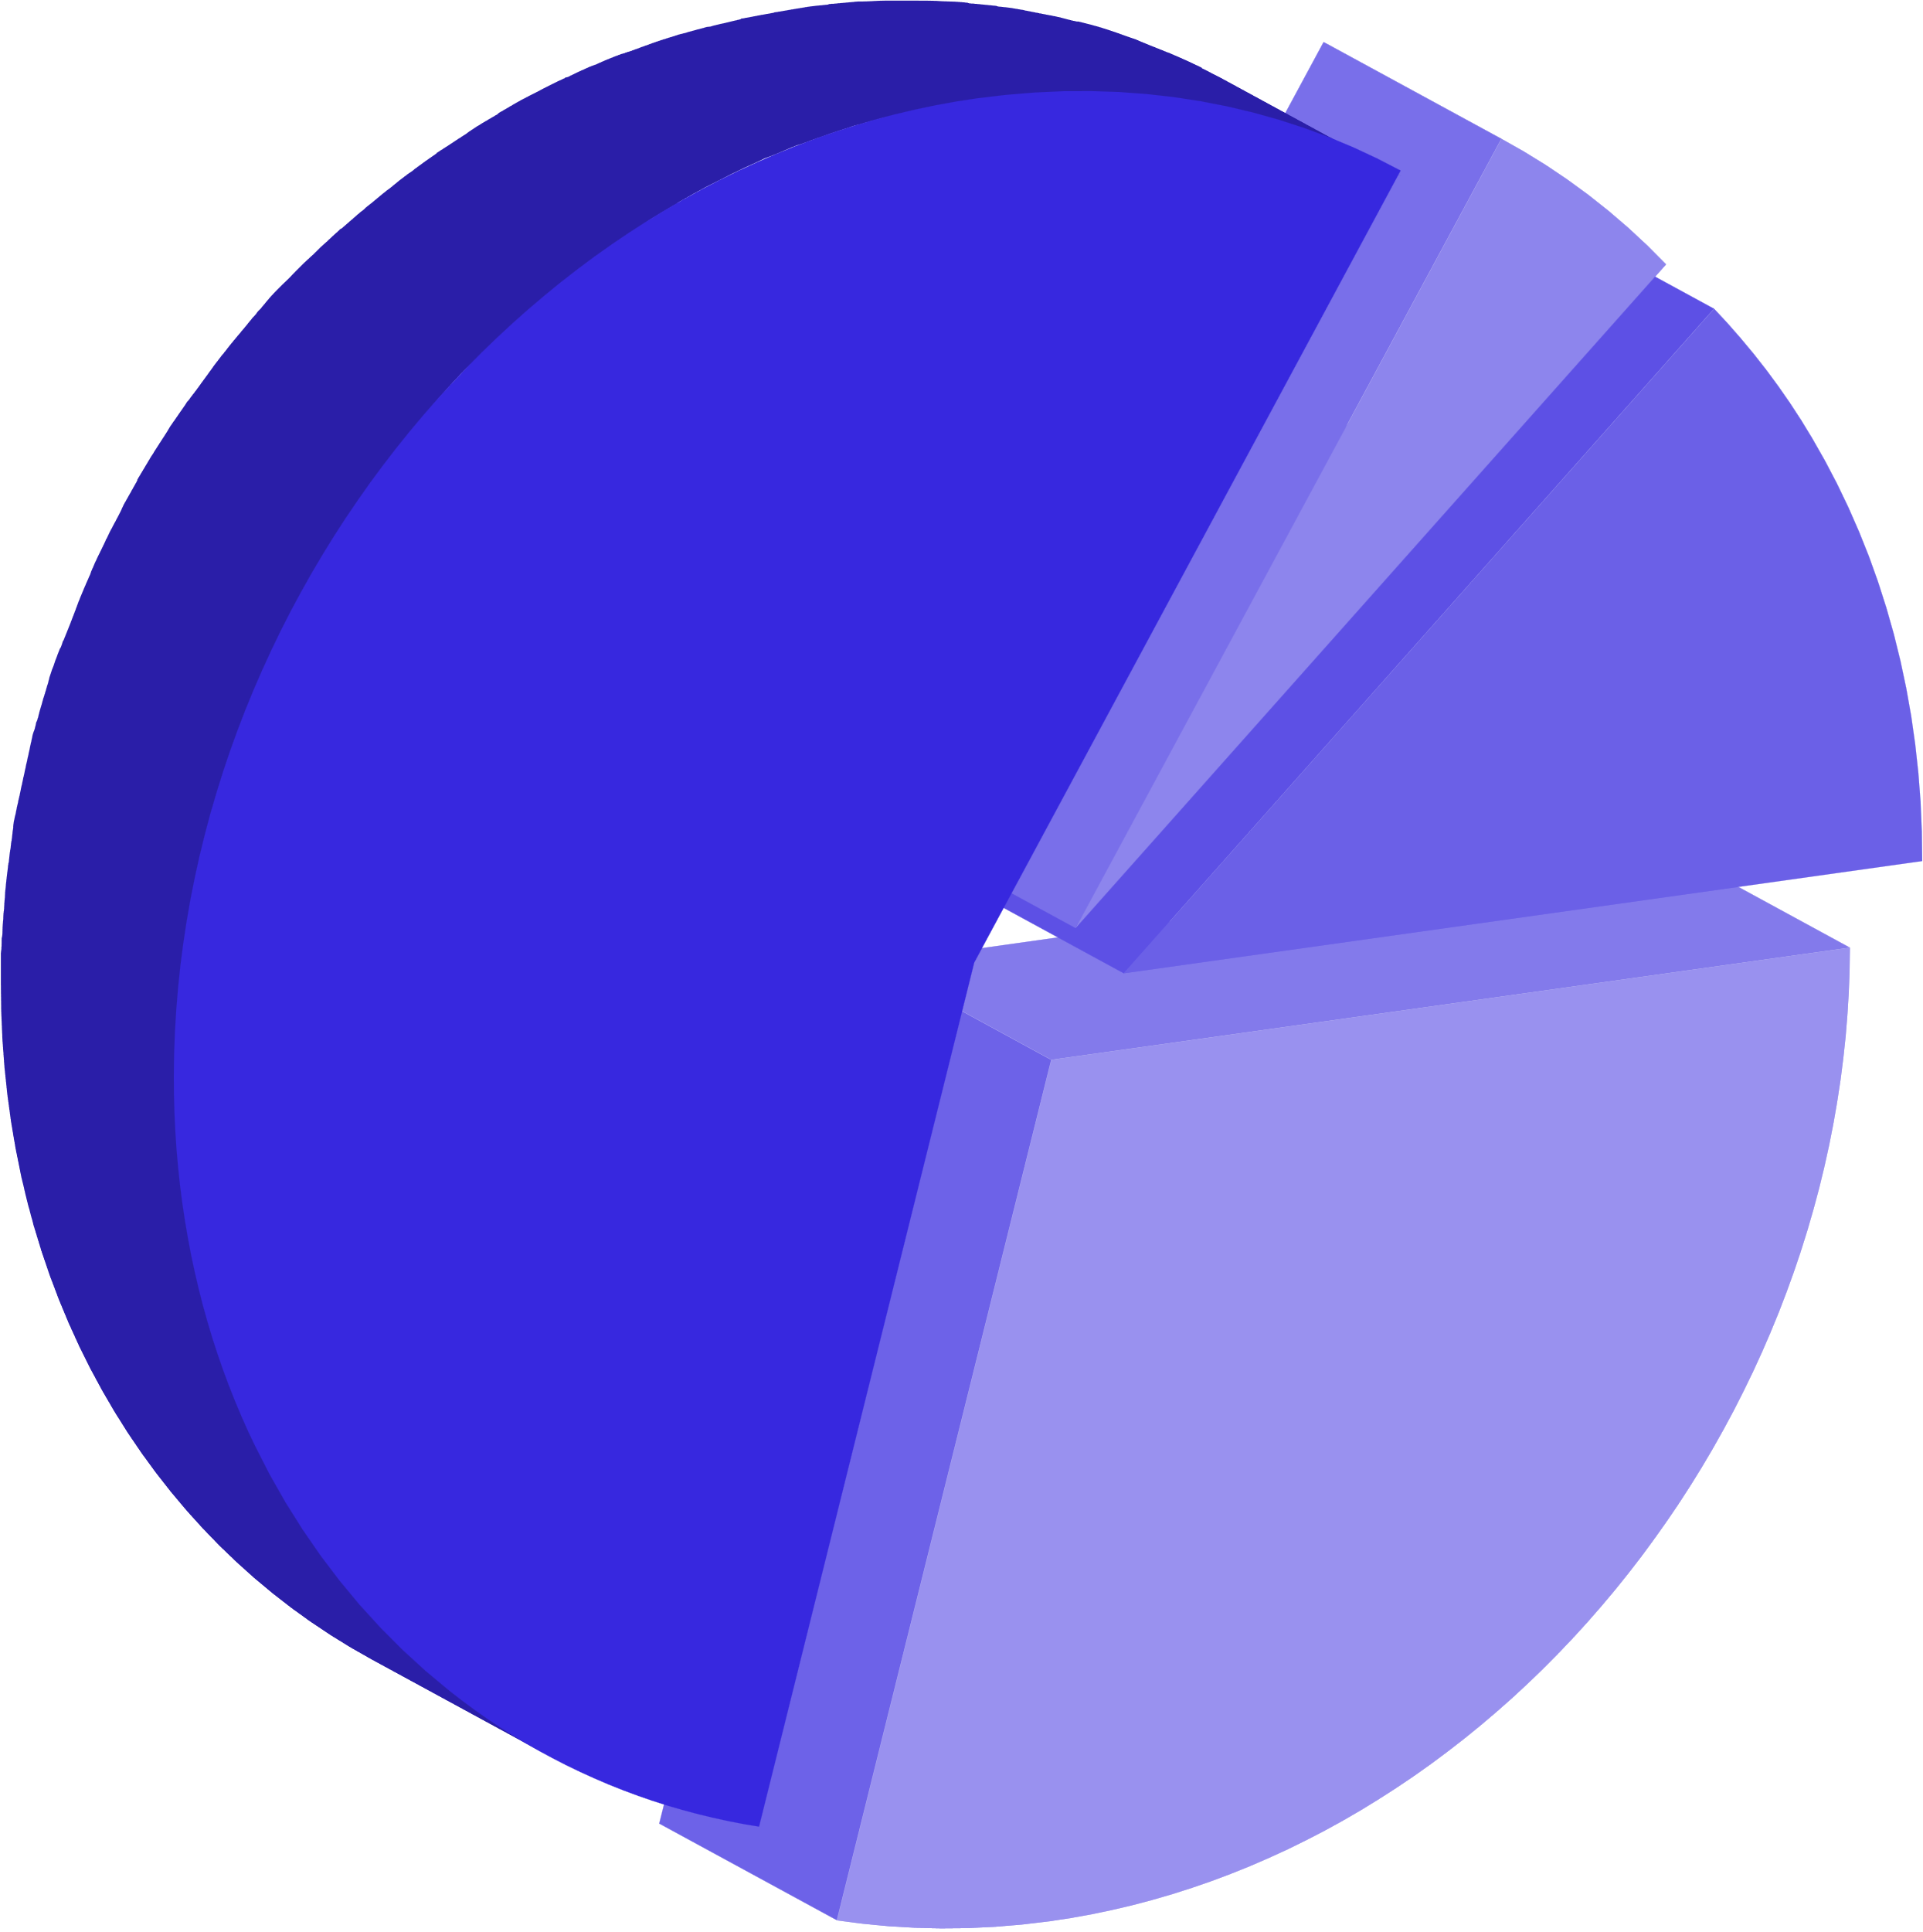
Weighted Least Squares Model
Good fit: Large R^2 value
Fulfills all 4 assumptions
Coefficient size makes more sense

Slide 41
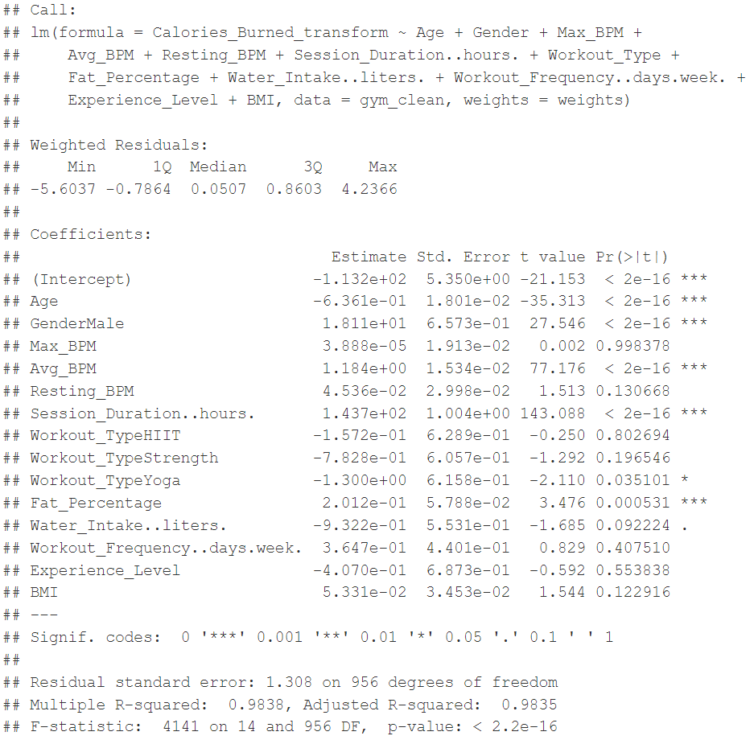
Summary
of model

Slide 42
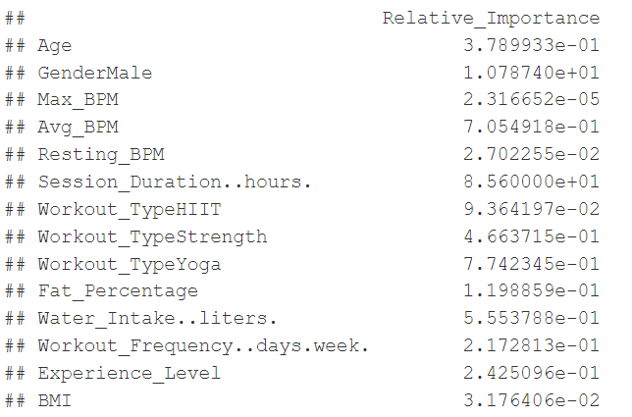
Relative importance

Slide 43
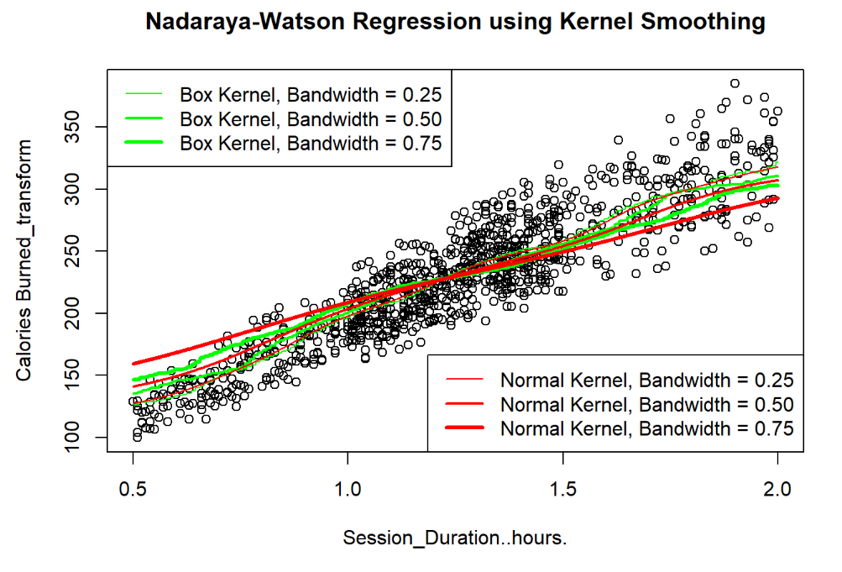
Nadaraya-Watson Regression

Slide 44
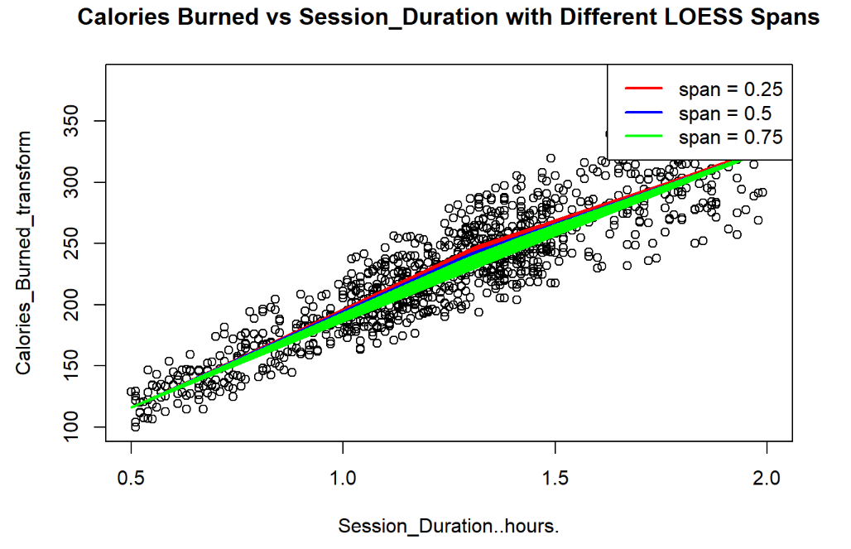
LOESS Technique

Slide 45
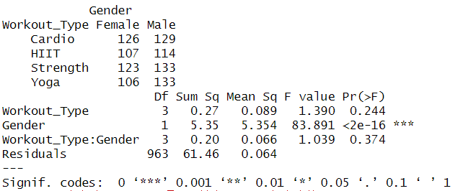
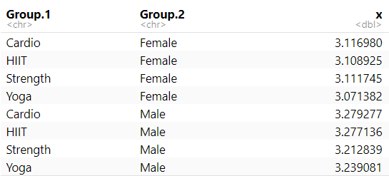
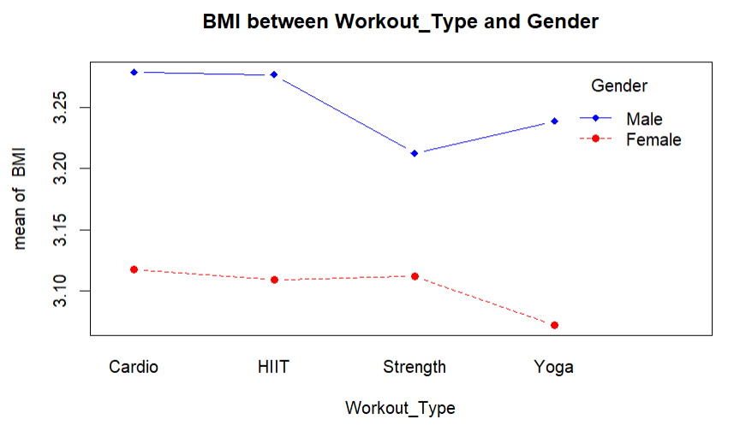
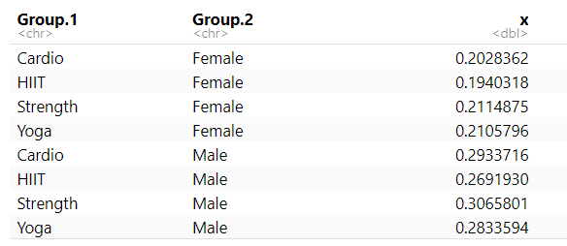
Two-way factorial ANOVA
不同 Workout_Type 和 Gender 组合下的 BMI 均值及标准差
summary

Slide 46
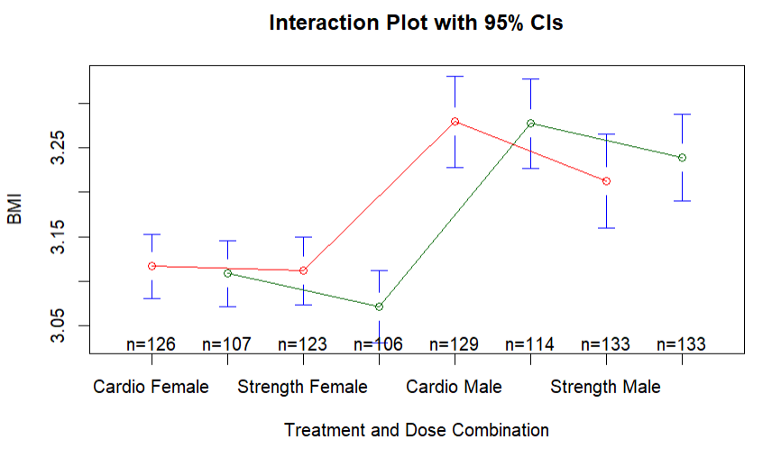
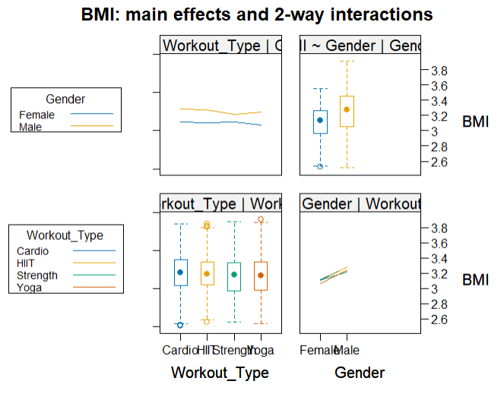
从图中可以看出四种锻炼方式对BMI影响不大，同时男性BMI比女性略高，不同性别中运动形式趋势相似，而力量训练中性别影响程度较小
带有95%置信区间的均值图，展示不同 Workout_Type 和 Gender 组合下的 BMI 均值。这有助于直观地比较不同群体之间的差异。

Slide 47
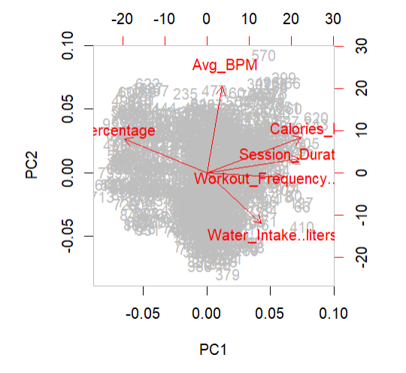
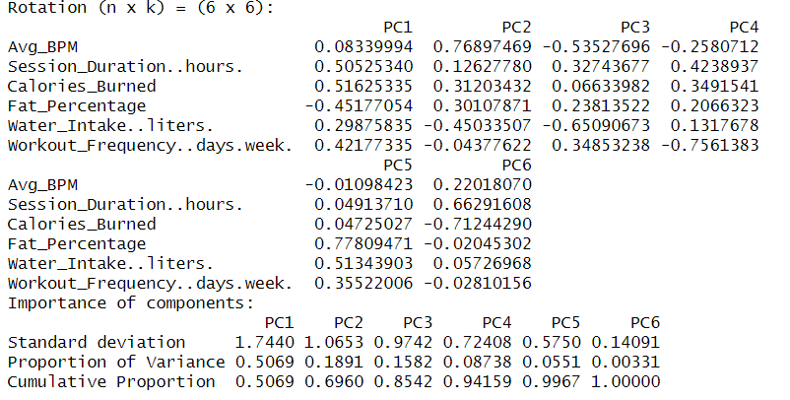


PCA(主成分分析)
各部分对BMI影响的权重
PC1（第一主成分）主要由单次锻炼时长、卡路里消耗量和每周锻炼频率决定，这些变量在PC1上有较高的载荷，表明PC1可能代表了训练活动的总体强度或频率，解释了数据集中50.69%的方差，是最重要的主成分。
PC2（第二主成分）与平均心率和水分摄入量有较强的相关性，但方向相反（一个正一个负），可能意味着心率和水分摄入之间的某种对立关系。
PC3主要由水分摄入量的负载荷和体脂率的正载荷决定，可能表示水分摄入较少与体脂率较高之间有关联。
PC2和PC3分别解释了18.91%和15.82%的方差，进一步增加了对方差的总解释。
PC4、PC5和PC6则涉及更复杂的变量组合，但载荷相对较低。

Slide 48


ANCOVA(协方差分析)
在这两个ANOVA表中，Calories_Burned对BMI的影响接近显著性水平，但不完全显著。这可能需要进一步的研究或更大的样本量来确认其影响。
Workout_Type及其与Calories_Burned的交互项对BMI的影响均不显著。
Calories和Workout_Type在有无相互作用的情况下对BMI的影响

Slide 49



综上所述，两个方差分析表均表明，在当前的数据集和模型设定下，消耗的卡路里和性别对BMI有显著影响。同时，消耗的卡路里与性别的交互作用对BMI的影响非常小，不显著。
性别和消耗卡路里在有无相互作用的情况下对BMI的影响

Slide 50


Two Sample t-test
综上所述，我们可以得出以下结论：
在每周运动时间和经验等级上，男性和女性之间没有显著的均值差异。
在卡路里，女性组的均值显著低于男性组。
在BMI上，女性组的均值也显著低于男性组。
这符合我们最初的预期

Slide 51



Hierarchical Clustering

Slide 52



K-means Clustering
对于两个类别的聚类结果，类别1的BMI、锻炼频率和卡路里消耗普遍低于类别2，而锻炼时长则相近。
对于八个类别的聚类结果，各个类别的特征差异更为明显。例如，类别1的BMI最低，锻炼频率和卡路里消耗也较低；而类别5的BMI最高，锻炼频率中等，卡路里消耗和锻炼时长则较低。

Slide 53



Model-based Clustering (BIC)
从BMI来看，聚类4的BMI平均值最高（38.64），可能表示这个聚类中的个体体重较重。
锻炼频率方面，聚类1的频率最高（4.54天/周），而聚类3的频率最低（2.42天/周）。
热量消耗方面，聚类1的热量消耗最高（298.03卡路里），而聚类3的热量消耗最低（153.17卡路里）。
锻炼持续时间方面，聚类1的持续时间最长（1.76小时），而聚类3的持续时间最短（0.75小时）。

Slide 54

Conclusion
Insights

Slide 55
Most Significant Predictors
Session Duration
Gender
Supported by coefficient and relative importance values
Greatest Impact on Calories Burned

Slide 56



Extension of Exercise Duration
Expends more energy
More helpful for weight loss goals
Most effective in achieving physical health benefits
Enjoy higher dopamine levels (“happy” hormones)
Insights
Impact of Study
Useful for gyms and fitness trainers to tailor their exercise regimes
Motivates exercise-goers to exercise longer, instead of more frequently
Limitations of Study
Sample size cannot represent all
Lack of consideration for intensity of exercises
Subjectivity of variables used, eg. Experience level

Slide 57

Thank you!

